Slide 1


Project Presentation – 1 (KCS 753) TrueCheck - Counterfeiting Detection System
KIET Group of Institutions, Ghaziabad
(An ISO – 9001: 2008 Certified & ‘A+’ Grade accredited Institution by NAAC)
Guide: Dr. Harsh Khatter
1. Archit Rajesh Srivastava CS-7A 2000290120039
2. Bhoomika Saxena CS-7A 200290120057
3. Ankita Jain CS-7A 200029012003925

Slide 2
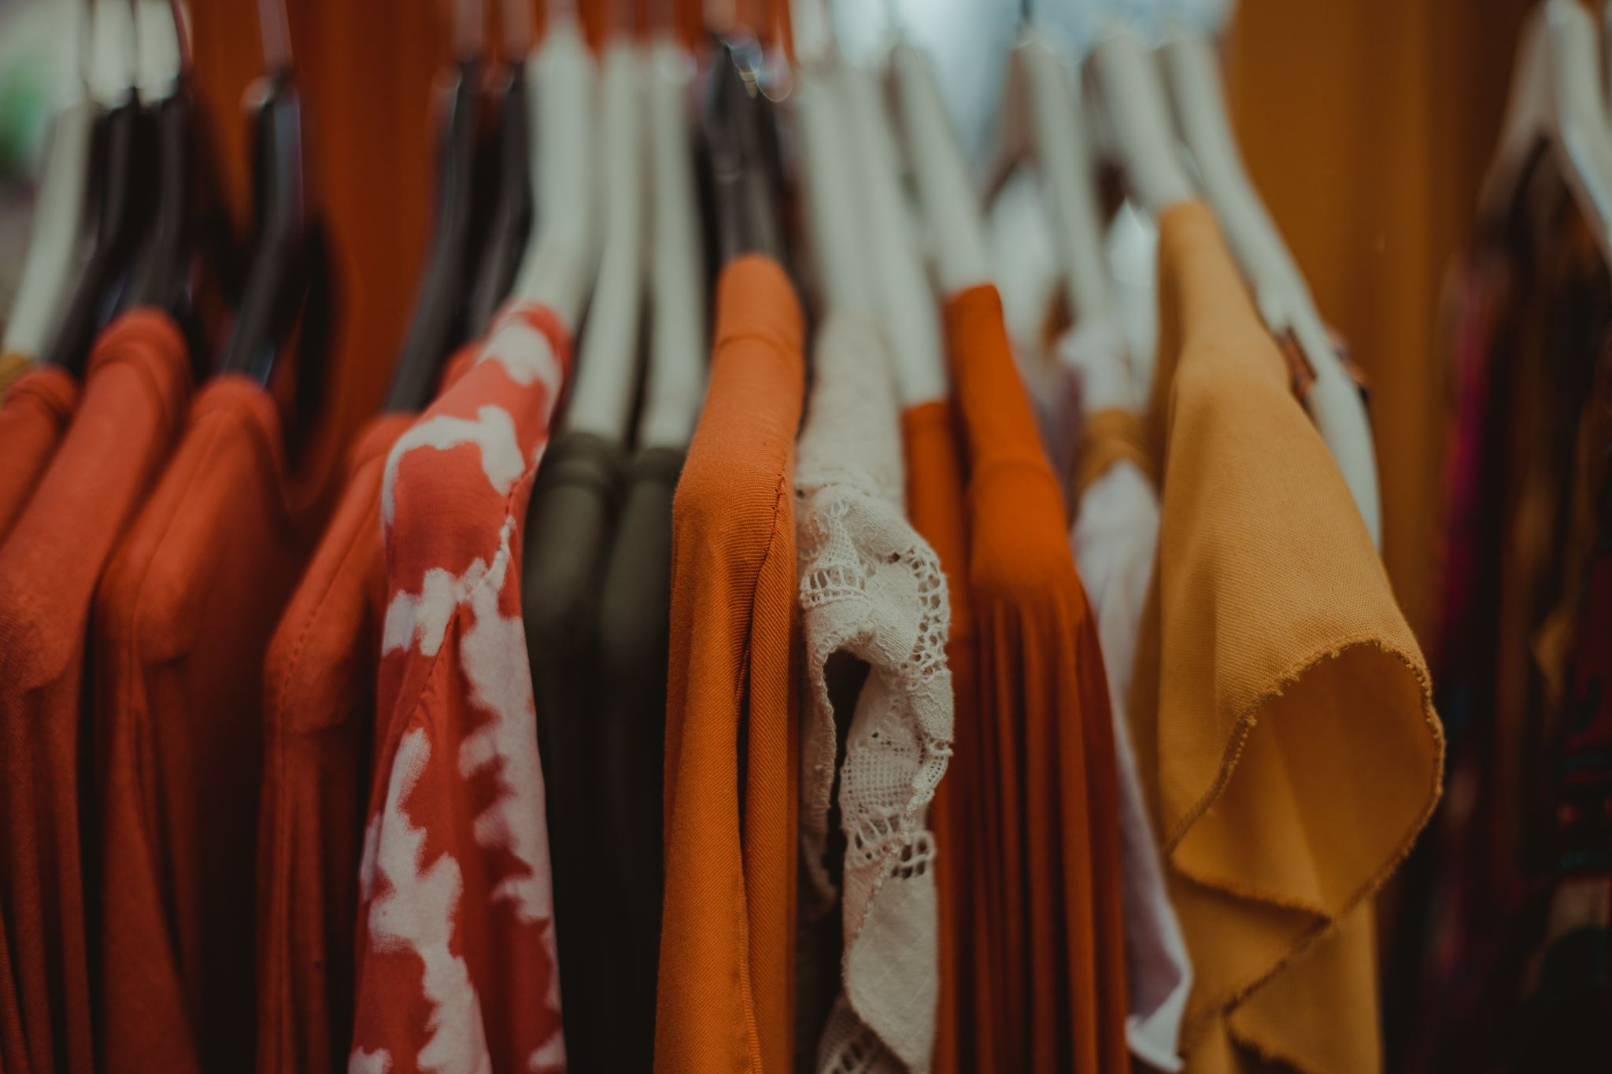
Problem Statement
Counterfeit clothing products undermine brand trust and consumer safety.
We need an efficient solution to detect and prevent counterfeit clothing sales, ensuring authenticity and transparency within the market.

Slide 3

Objectives
Develop a robust Counterfeit Detection System i.e., TrueCheck.
Enable consumers to verify the authenticity of clothing products easily.
Provide essential product details via QR code scanning.
Reduce financial losses incurred by companies due to counterfeit sales.
Safeguard and enhance the reputation of authentic brands.
Create a counterfeit-free shopping experience for consumers.

Slide 4

Technology Used
Front end
HTML
CSS
JavaScript
Bootstrap
Backend
NodeJS
Python
MySQL
Version Control
Git/GitHub
VSCode

Slide 5
Literature Survey 1
Paper Title: An Introduction to QR Code Technology
Author Name: Sumit Tiwari
Journal Name: International Conference on Information Technology
Year of publishing: 2016
QR codes are 2D matrix codes with high data storage capacity.
Consist of black modules in a square pattern on a white background.
Advantages of 2D QR Code over 1D barcodes is faster readability, error correction, versatility.
Widely used in marketing, security, and academia.
Popular for tracking, labelling, and quick information access.
Adoption boosted by the increasing number of smartphone users.
QR code versions range from 1 to 40, affecting size and capacity.
Structure includes finder patterns, separators, timing patterns, and alignment patterns.
Encoding region holds version info, format data, and error correction codewords.
QR codes are globally accepted and continue to grow in popularity.

Slide 6
Literature Survey 2
Paper Title: A study on counterfeit brands, consumer attitude and initiatives to stop counterfeiting in India
Author Name: Ashok Kumar Patel & Anurag Singh
Journal Name: AD VALOREM - Journal of Law
Year of publishing: 2018
This paper addresses counterfeiting in India, emphasizing its global significance and the need for comprehensive solutions:
Counterfeiting impacts industries and economies worldwide.
Counterfeit brands exploit genuine product reputations and pose risks to consumers.
Counterfeiting is pervasive in industries like luxury goods, electronics, pharmaceuticals, and packaged foods.
The global economic value of counterfeit products is projected to reach $2.3 trillion by 2022.
Consumer Influence and Legal Gaps:
Positive consumer attitudes, driven by lower prices and perceived luxury, contribute to counterfeiting growth.
Weak legal frameworks and enforcement challenges exacerbate the problem
Market Insights:
Understanding counterfeit market share in different sectors is crucial.
This knowledge helps genuine brand stakeholders develop effective countermeasures.
Overall Objective:
The research paper aims to increase awareness, combat counterfeiting, and protect legitimate businesses and consumers in India.

Slide 7
Literature Survey 3
Paper Title: Counterfeit detection with QR Codes
Author Name: Justin Picard, Paul Landry & Michael Bolay
Journal Name: ACM Symposium on Document Engineering
Year of publishing: 2021
Advantages of QR Codes:
QR Codes are highlighted as an effective solution due to their ease of integration into production workflows, simplicity of verification, and cost-effectiveness at scale.
They also convey a product's digital identity and history, enhancing brand-consumer connections.
Limitations of QR Codes:
QR Codes alone may not provide sufficient protection against cloning or copying.
To address this, the authors propose integrating copy detection patterns (CDPs) into QR Codes.
CDPs are copy-sensitive layers that can be scanned and analysed with a smartphone app, differentiating between genuine products and counterfeits.
Challenges in Real-world Environments:
Implementing counterfeit detection in mass production environments where QR Codes are used is challenging.
Existing techniques for securing QR Codes have not been extensively tested in such settings.
The authors present a system that successfully incorporates CDPs into QR Codes and has been deployed in the market for several years.
Review of Existing Solutions:
The paper briefly reviews other methods for securing QR Codes against counterfeiting, such as embedding random textures or replacing specific texture patterns in the QR Code cells.

Slide 8
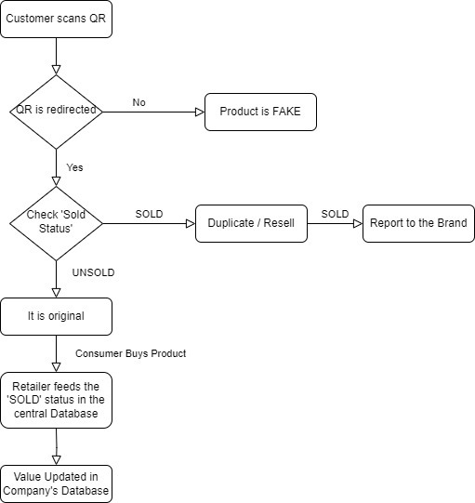
Workflow Diagram

Slide 9

Patent Status

Slide 10
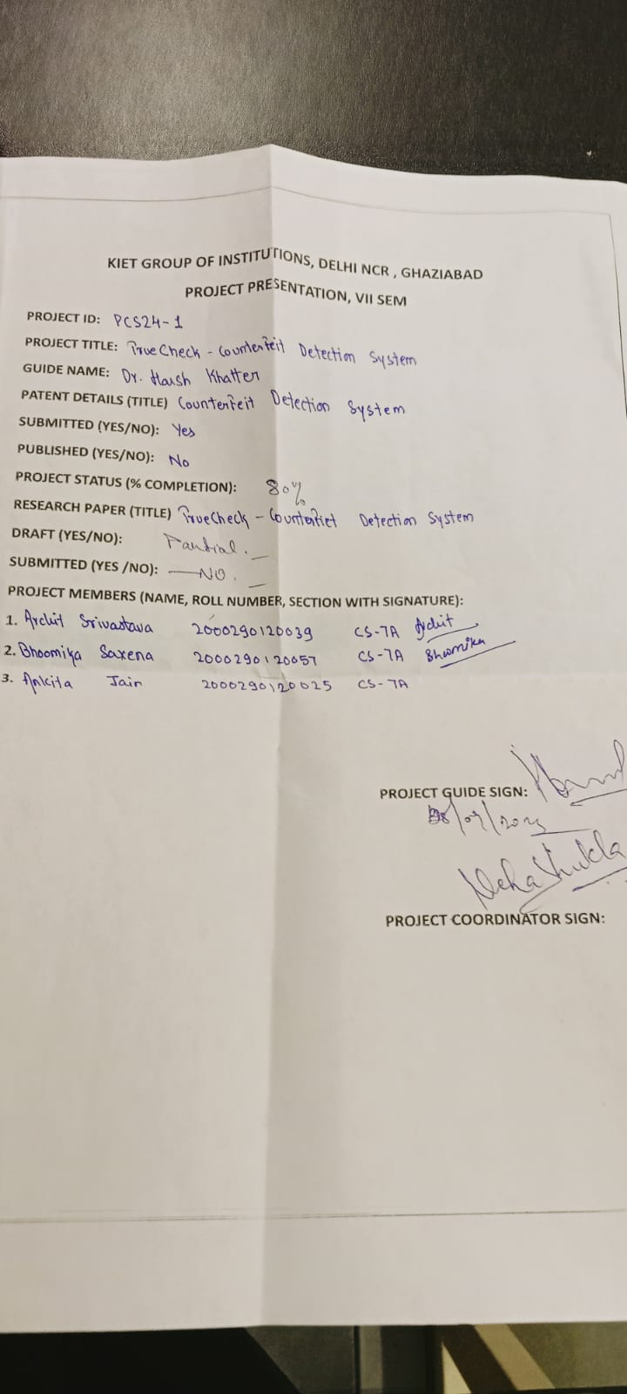
Research Paper Status

Slide 11
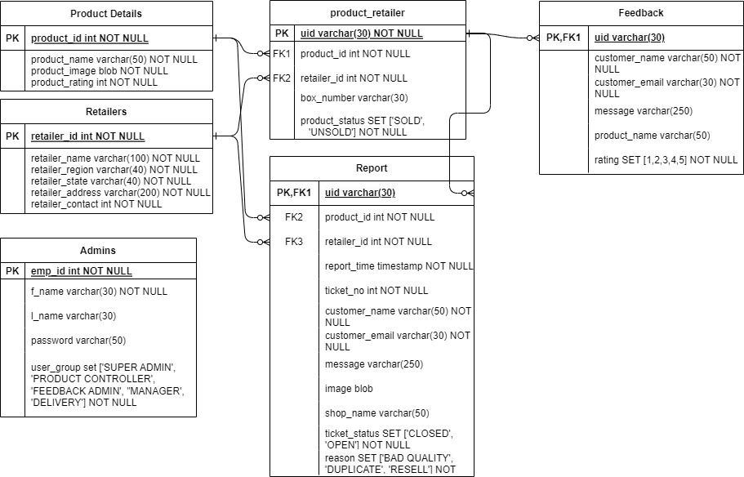
ER Diagram

Slide 12
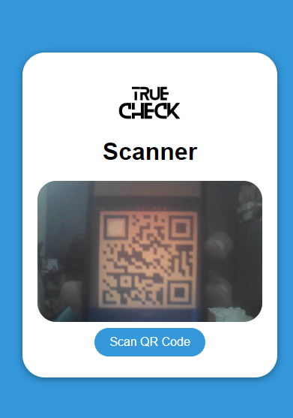
Consumer End

Slide 13
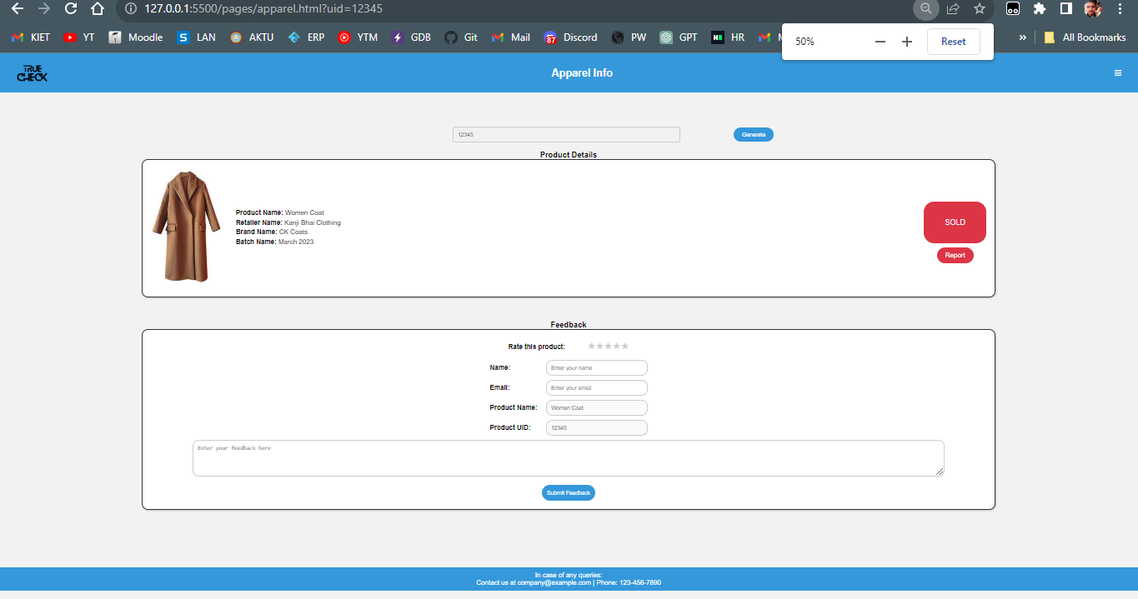

Slide 14
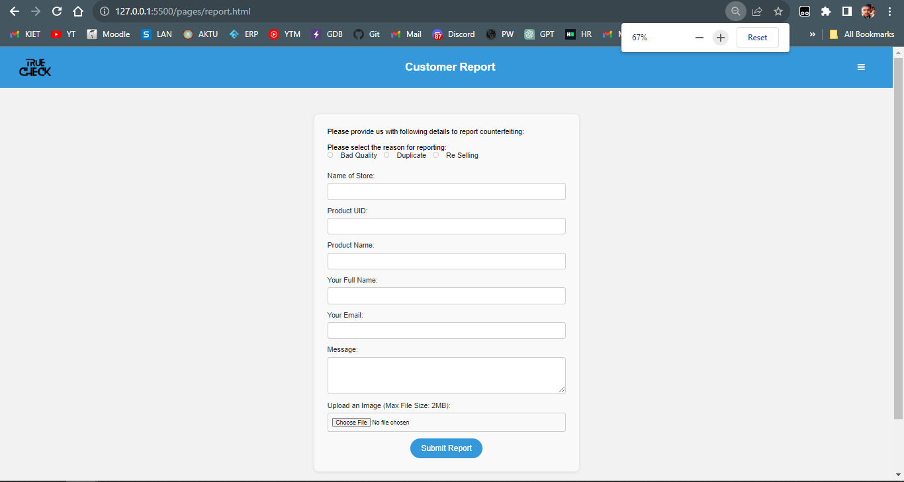

Slide 15
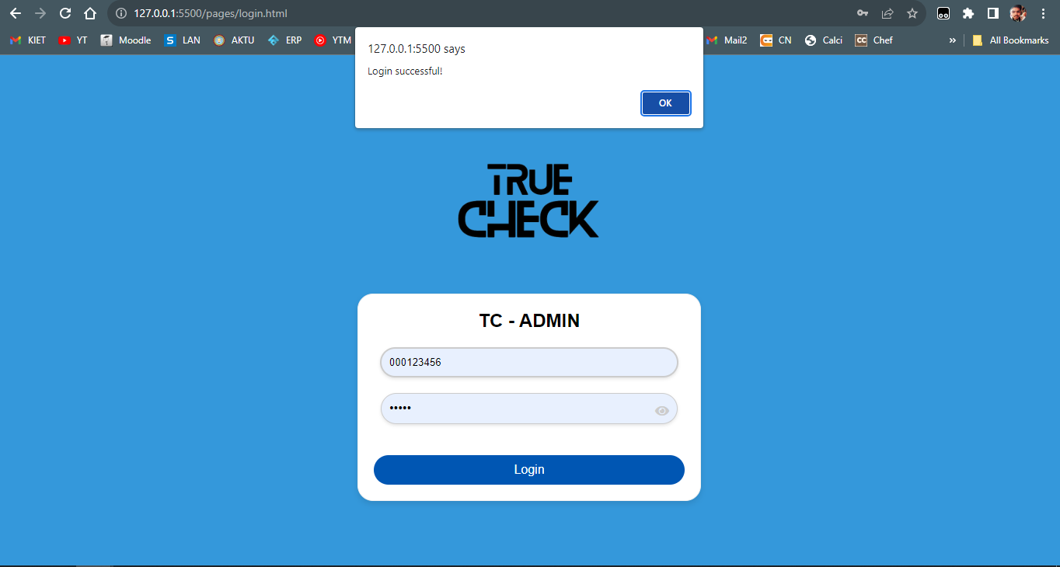
Company End

Slide 16
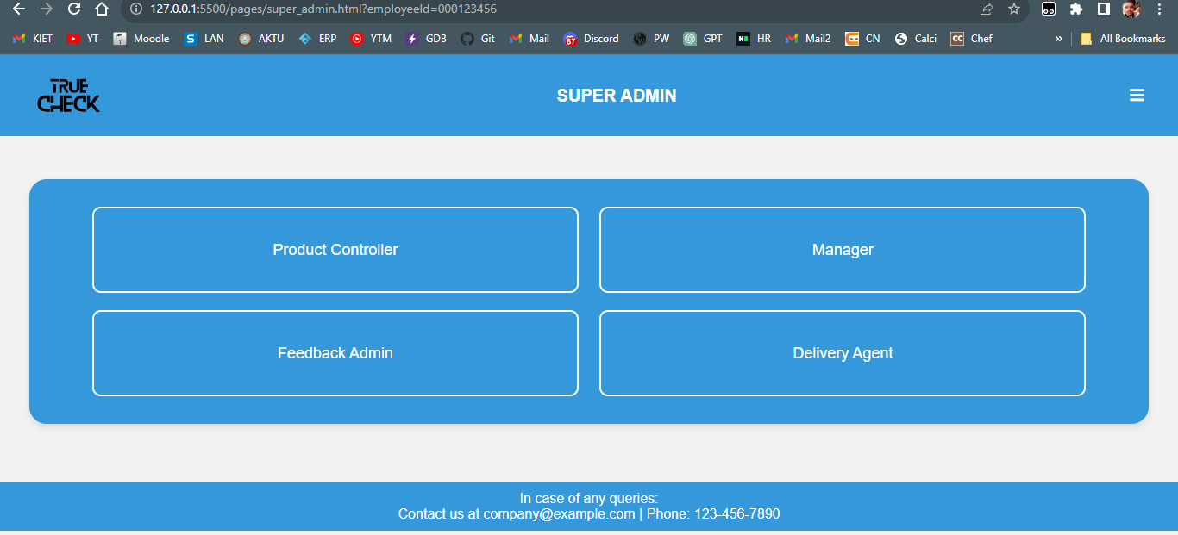
SuperAdmin Screen:

Slide 17
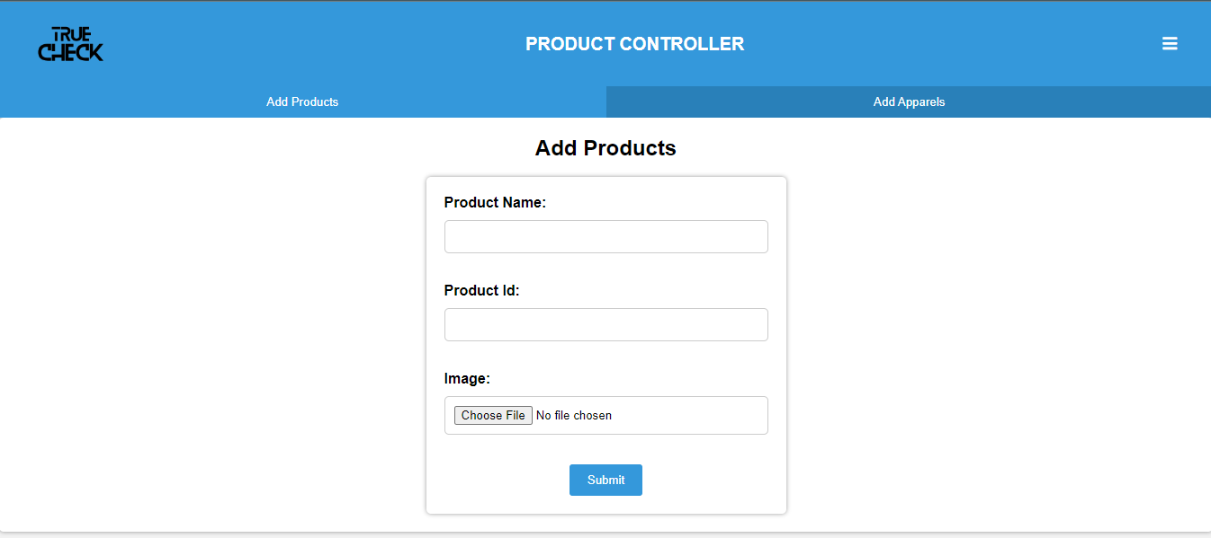
Product Controller Screen 1:

Slide 18
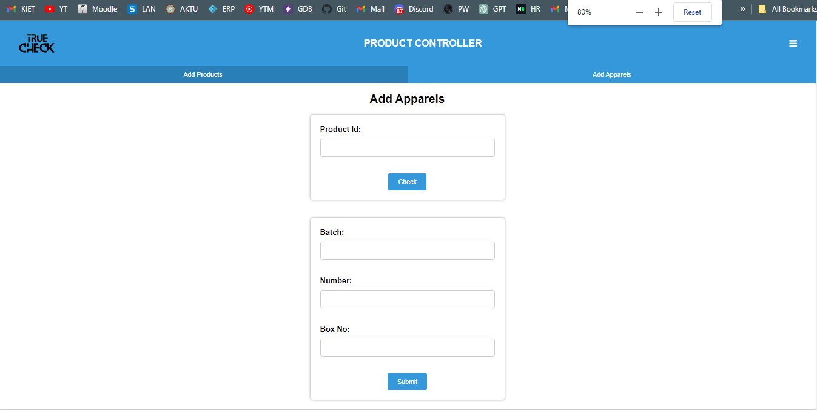
Product Controller Screen 2:

Slide 19
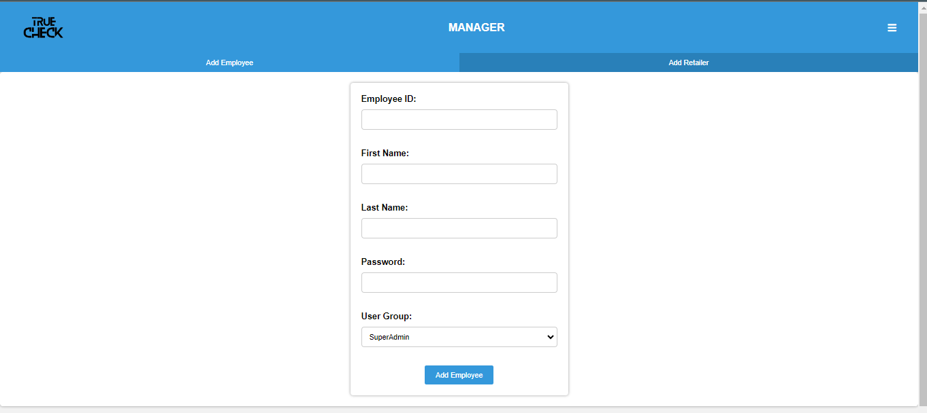
Manager Screen 1:

Slide 20
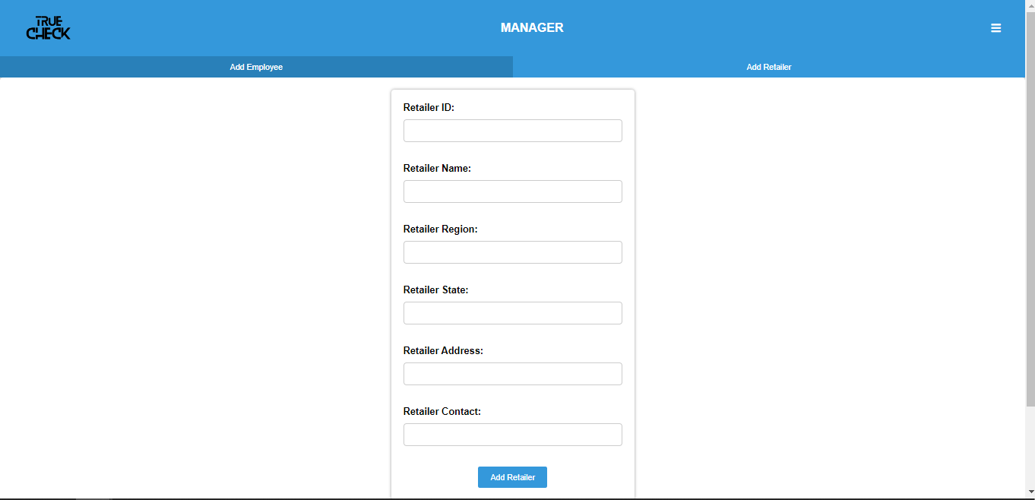
Manager Screen 2:

Slide 21
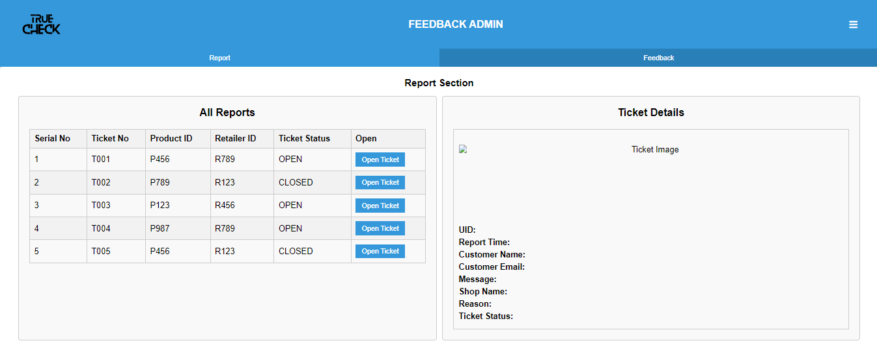
Feedback Admin Screen 1 :

Slide 22
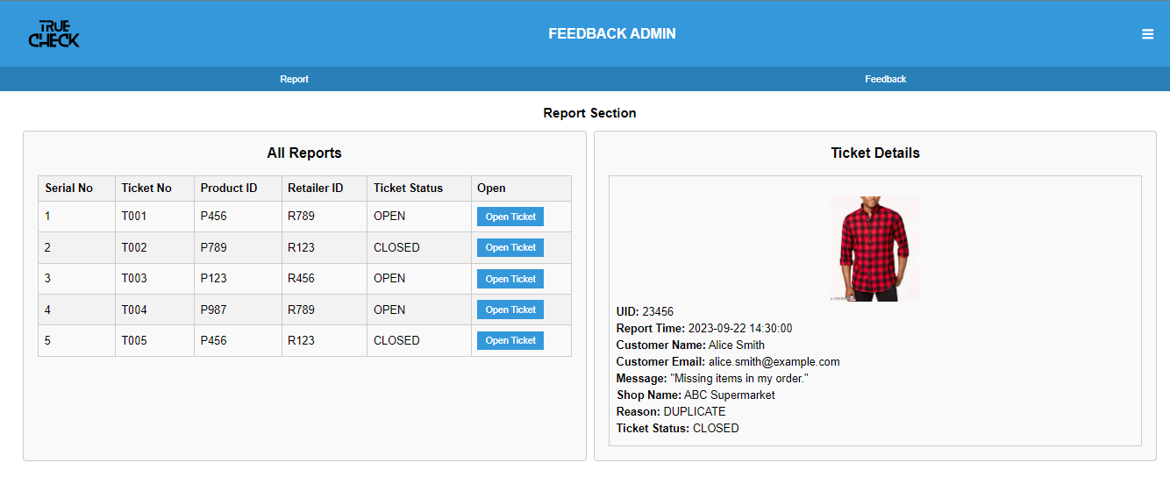
Feedback Admin Screen 2 :

Slide 23
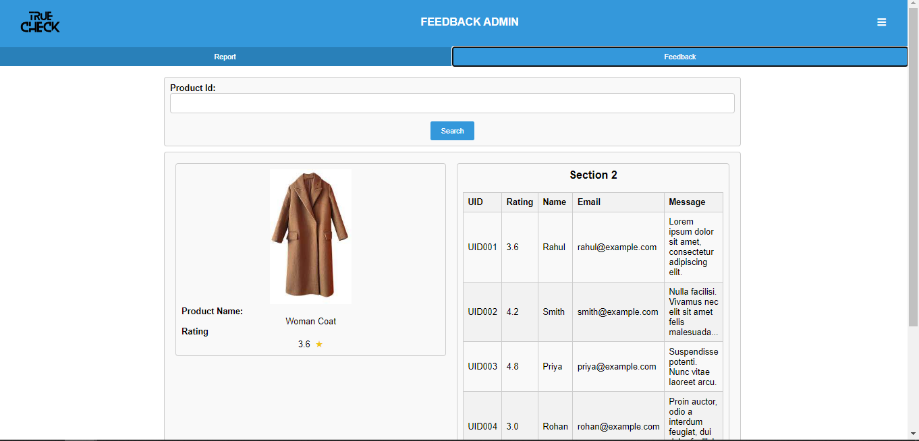
Feedback Admin Screen 3 :

Slide 24
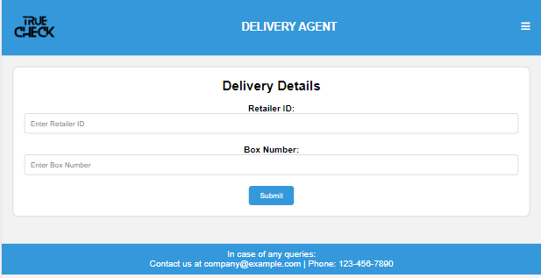
Delivery Agent

Slide 25


Admin Error Page
Other Errors

